Slide 1
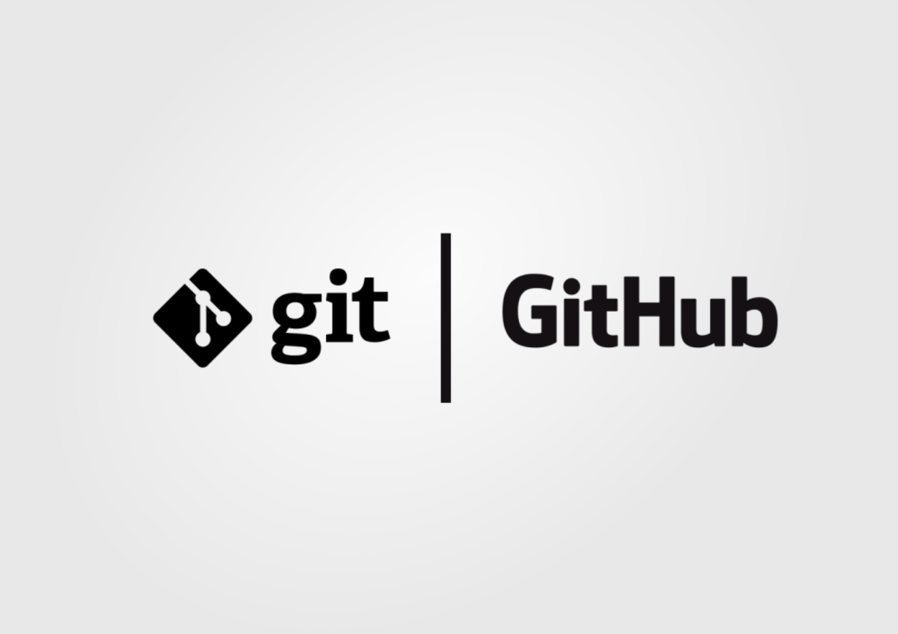
Mastering Git Basics
Essential Concepts for Version Control
Photo by Pexels

Slide 2
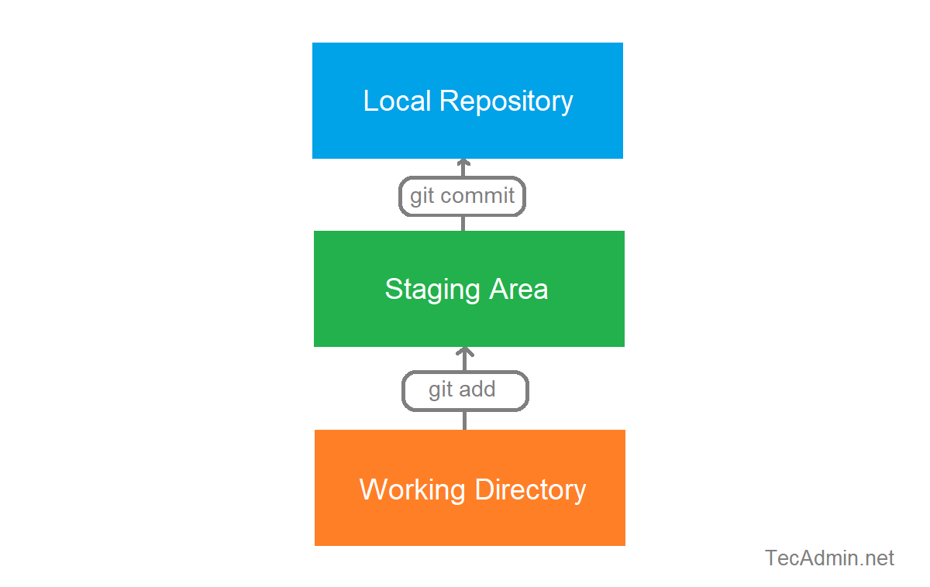
Table of Contents
01
Understanding Git
02
The Significance of Commits

Slide 3
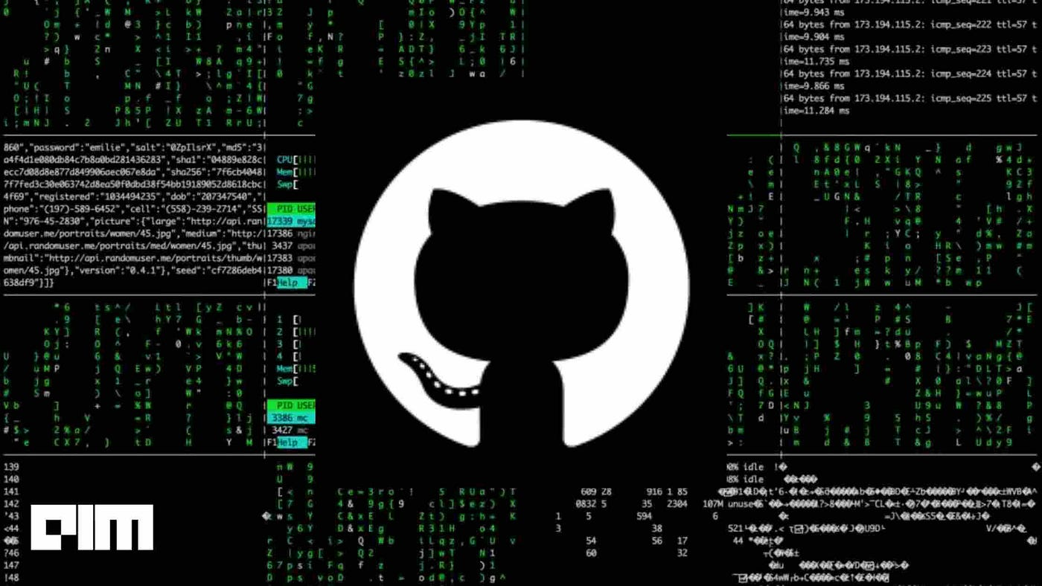
1
Understanding Git
Version Control
Git is a distributed version control system used for tracking changes in source code during software development.
It allows developers to collaborate, maintain code history, track changes, and revert to previous versions when necessary.
Git performs actions like branching, merging, committing changes, and resolving conflicts, essential for efficient collaboration and project management.
With Git, developers can work on the same codebase simultaneously, minimizing errors and enabling seamless integration of changes.
Photo by Pexels

Slide 4
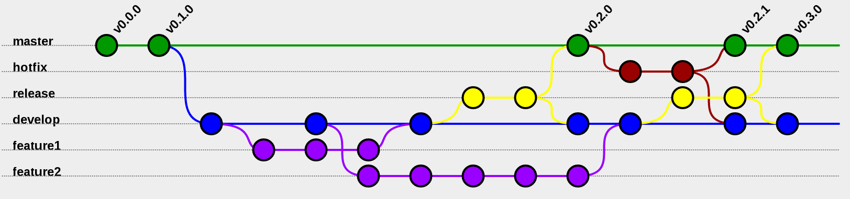
2
The Significance of Commits
Tracking Changes
A commit in Git is a snapshot of the repository at a specific point in time, capturing changes made to the files.
Commits enable developers to track modifications, review code history, and understand the evolution of the project over time.
By creating commits, developers have a detailed record of changes, making it easier to identify bugs, errors, and roll back to previous states if needed.
Git's commit mechanism allows for granular tracking, ensuring accountability and providing a clear audit trail of code alterations.
Photo by Pexels

Slide 5


